Slide 1
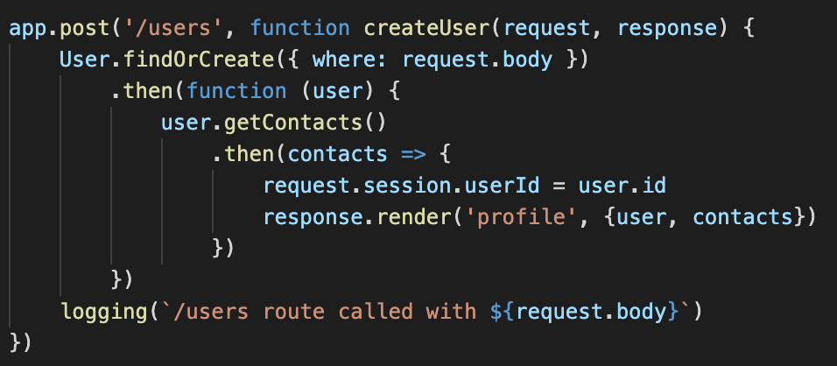

Slide 2
createUser()
findOrCreate()
anonymous(user)
STACK
PENDING CALLBACKS
getContacts()
anonymous(contacts)
logging()

Slide 3
findOrCreate()
anonymous(user)
STACK
PENDING CALLBACKS
getContacts()
anonymous(contacts)
logging()
createUser()

Slide 4
anonymous(user)
STACK
PENDING CALLBACKS
getContacts()
anonymous(contacts)
logging()
createUser()
findOrCreate()

Slide 5
anonymous(user)
STACK
PENDING CALLBACKS
getContacts()
anonymous(contacts)
logging()
createUser()
findOrCreate()

Slide 6
anonymous(user)
STACK
PENDING CALLBACKS
getContacts()
anonymous(contacts)
createUser()
findOrCreate()

Slide 7
anonymous(user)
STACK
PENDING CALLBACKS
getContacts()
anonymous(contacts)
findOrCreate()

Slide 8
anonymous(user)
STACK
PENDING CALLBACKS
getContacts()
anonymous(contacts)
findOrCreate()

Slide 9
STACK
PENDING CALLBACKS
getContacts()
anonymous(contacts)
findOrCreate()
anonymous(user)

Slide 10
STACK
PENDING CALLBACKS
getContacts()
anonymous(contacts)
anonymous(user)

Slide 11
STACK
PENDING CALLBACKS
getContacts()
anonymous(contacts)
anonymous(user)

Slide 12
STACK
PENDING CALLBACKS
anonymous(contacts)
anonymous(user)
getContacts()

Slide 13
STACK
PENDING CALLBACKS
anonymous(contacts)
getContacts()

Slide 14
STACK
PENDING CALLBACKS
anonymous(contacts)
getContacts()

Slide 15
STACK
PENDING CALLBACKS
getContacts()
anonymous(contacts)

Slide 16
STACK
PENDING CALLBACKS
anonymous(contacts)

Slide 17
STACK
PENDING CALLBACKS
anonymous(contacts)

Slide 18
STACK
PENDING CALLBACKS
response.render()

